Slide 1



Symposium: Somatic Distress Disorder MUS in Primary Care
Bart’s
6th May 2016

Slide 2
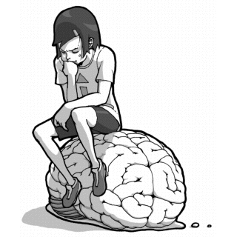
Mind and or over matter?
“Parity of esteem”
Improving physical health care for patients with SMI
Embodied cognition

Slide 3
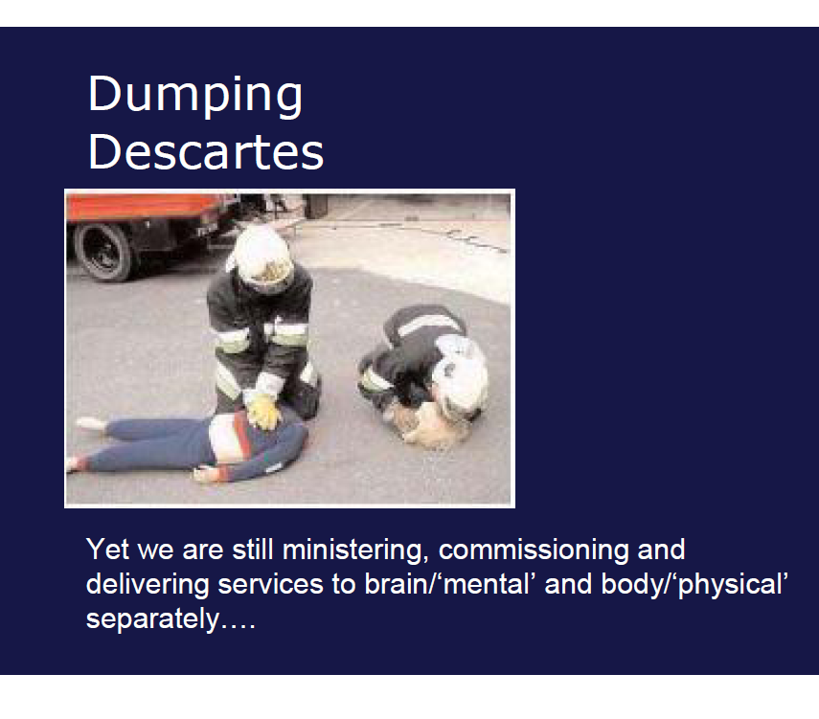

Slide 4
Therefore: we need…
resources to be more economically allocated; more effective treatments and support systems
Care to be better integrate between primary and secondary care
a better match of professional and patient perspectives towards the nature of somatic distress

