Slide 1
Treatment of patients with functional distress disorder in primary care …
… a general practitioner’s and commissioner's perspective
Phil Moore May 2016
phil@philmoore.org

Slide 2
What people are faced with …

Slide 3
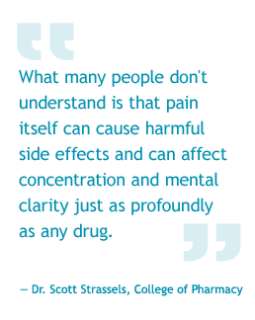

Slide 4
What people are faced with …
They’re tired
Fed up with the symptoms
They’re confused
Cannot understand why modern medicine cannot find out what is wrong
Surely another MRI … ?
They want a name for what they have
None of the names help them … and there are many unhelpful comments!
Do not feel able to fight it unless they can call it by name!
They’re disillusioned
Feel no one believes them
The concept of psychosomatic is ‘you’re imagining it’
And sick of encouraging comments from friends – ‘whatever doesn’t kill you …’

Slide 5
It can becomes a war of attrition

Slide 6
What GPs are faced with …

Slide 7
Undiagnosed
Diagnosis
‘Syndrome’

Slide 8
What GPs are faced with …
Part of the difficulty is it is difficult to define
Is illustrated by the variety of names
Psychosomatic
Somatisation disorder
Medically unexplained symptoms
Bodily distress syndrome
Functional & dissociative neurological disorder
Functional distress disorder
Somatic symptom disorder
So what is a GP to do?
Patients want to be able to name their ‘enemy’
Complex – and all I have is a few suggestions

Slide 9
Missing a diagnosis…
A patient with dementia
Intelligent, active, IT consultant
Lost ability to read a map
All investigations normal so tried an antidepressant
Later further assessment revealed a rare presentation of Lewy body dementia
It is usually the other way round
All GPs have people who go round and round the loop of investigation & treatment
And it feels really difficult to break the cycle
Woman with bilateral alendronate fractures who now has multiple pains and multiple OP clinic attendances

Slide 10
How real is the fear of wrong diagnosis?
This study collected together all the previous studies looking at how often doctors got the diagnosis of functional neurological symptoms wrong. Rates of misdiagnoisis have been around 5% since 1970. This is the error rate for all neurological conditions.
Stone et al BMJ. 2005; 331: 989;doi:10.1136/bmj.38628.466898.55

Slide 11
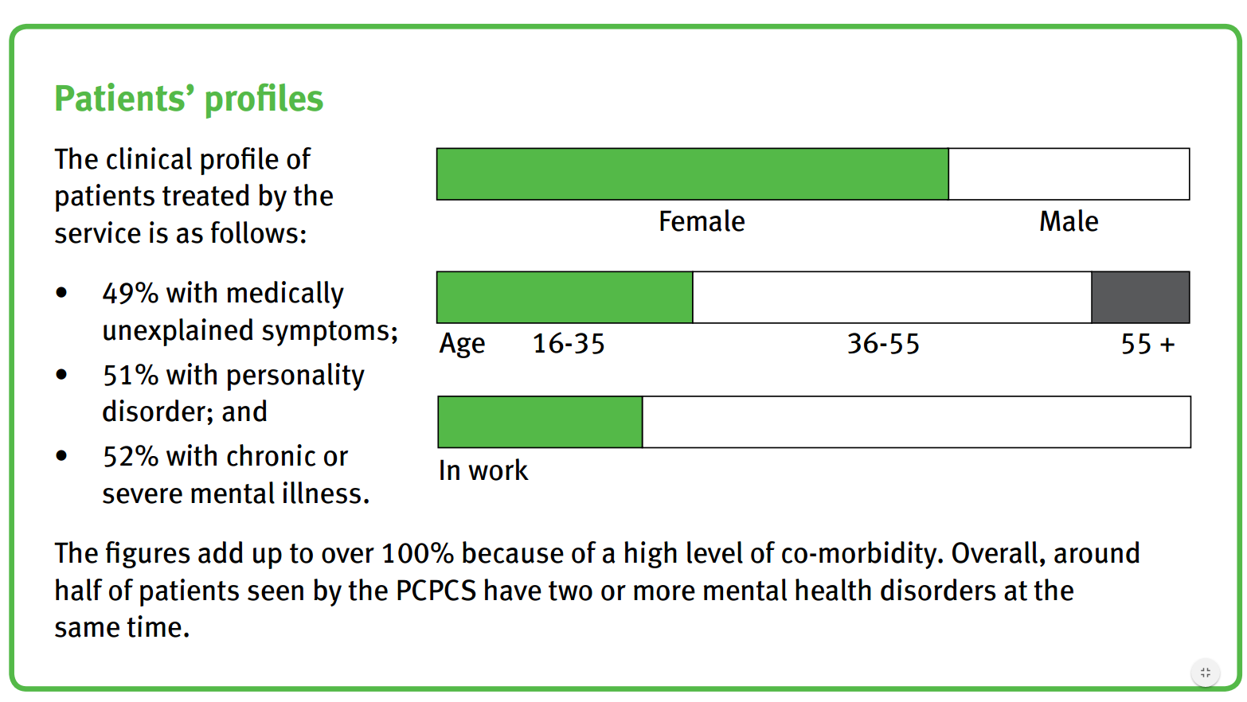
Co-morbidity
A major part of the issue is that a functional distress disorder often co-exists with a physical diagnosis or long-term condition
In the City and Hackney evaluation …

Slide 12
In this situation …
… does the doctor look different from the patient?

Slide 13
What commissioners are faced with …

Slide 14
What to commission …
What do we commission?
A specialised MUS/SSD/FDD clinic?
This group of people are already fed up with multiple attendances at clinics
And to get them there we need to have done the work on convincing them there is need for a psychological approach!
The psychological support needs to be embedded
In every service
Integration of physical and mental health services has to be the way forward
There is then no need for ‘onward referral’ but a holistic approach to dealing with the person not the condition

Slide 15
What to commission …
‘Commissioning of services which provide the whole of the MUS model of care will involve taking an integrated approach working across acute, primary care, practice based and mental health commissioning.’
Medically Unexplained Symptoms (MUS) – A whole systems approach
July 2009 – December 2010: Commissioning Support for London
http://www.londonhp.nhs.uk/wp-content/uploads/2011/03/MUS-whole-systems-approach.pdf
http://www.londonhp.nhs.uk/wp-content/uploads/2011/03/MUS-Project-Implementation-Report.pdf
That is a challenging piece of commissioning
But it has to be the way forward
Some moves towards it around a collaborative approach

Slide 16
Useful commissioner/GP resources
City & Hackney scheme
Infographic: https://www.youtube.com/watch?v=M_5VxIV-f3o
Evaluation: http://www.centreformentalhealth.org.uk/complex-needs-report
Practical tips for GPs
http://www.londonhp.nhs.uk/wp-content/uploads/2011/03/Executive-Summary-for-General-Practitioners.pdf
http://www.londonhp.nhs.uk/wp-content/uploads/2011/03/Practical-Tips-for-MUS.pdf
Useful site for neurological functional symptoms
http://www.neurosymptoms.org/#

Slide 17
Thank you
Phil Moore
phil@philmoore.org

